Slide 1
Diff eq ch 12

Slide 2
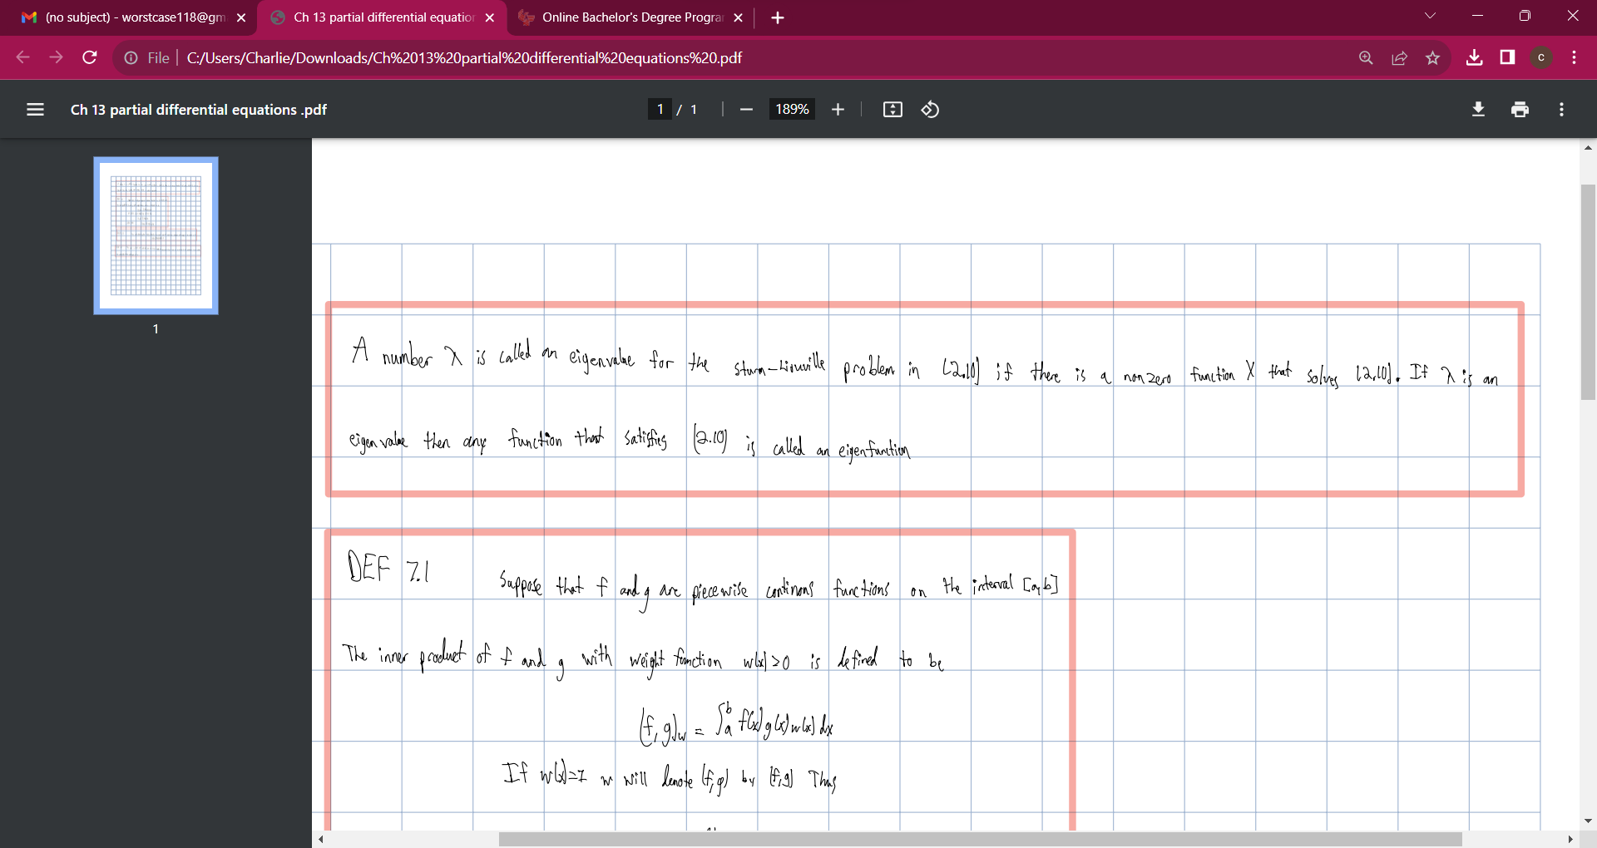

Slide 3
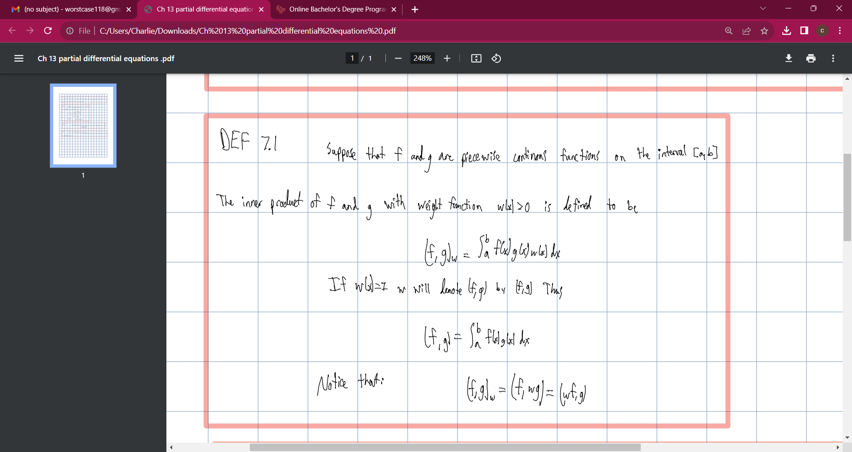

Slide 4
